Slide 1



Powered by:

Slide 2
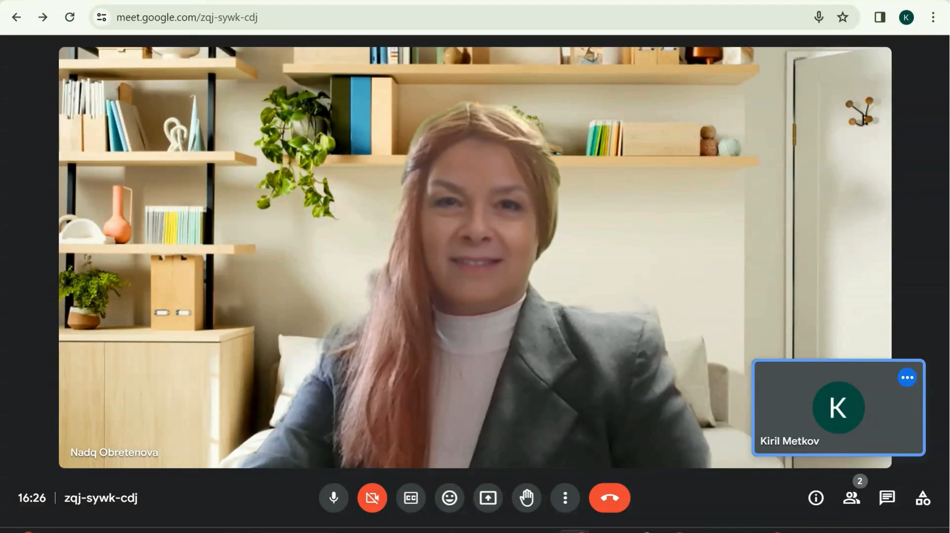


Slide 3
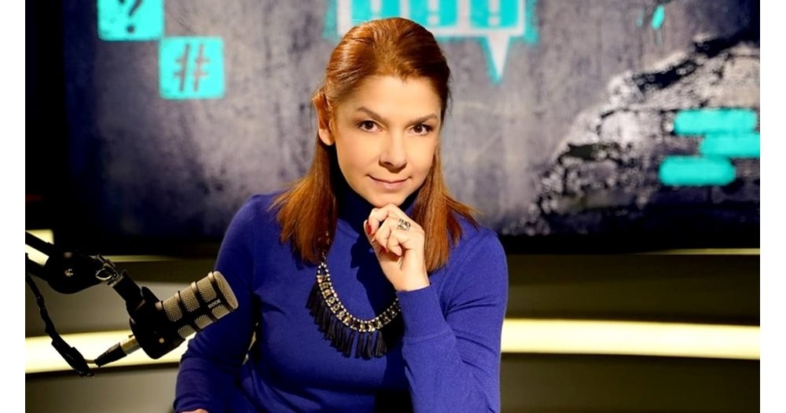
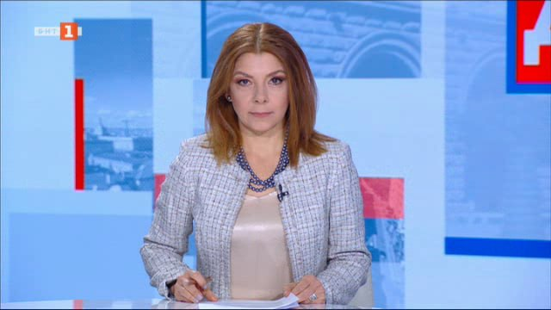
The real nadya

Slide 4
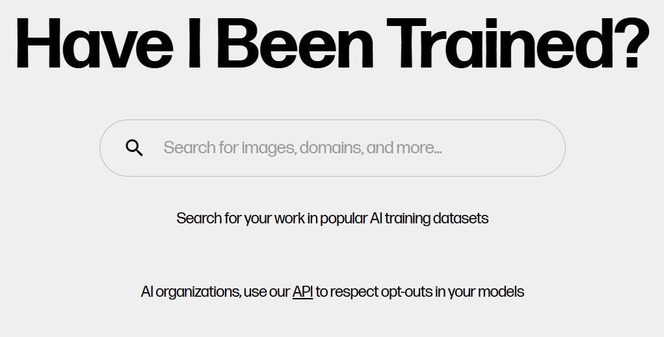
haveibeentrained.com

Slide 5
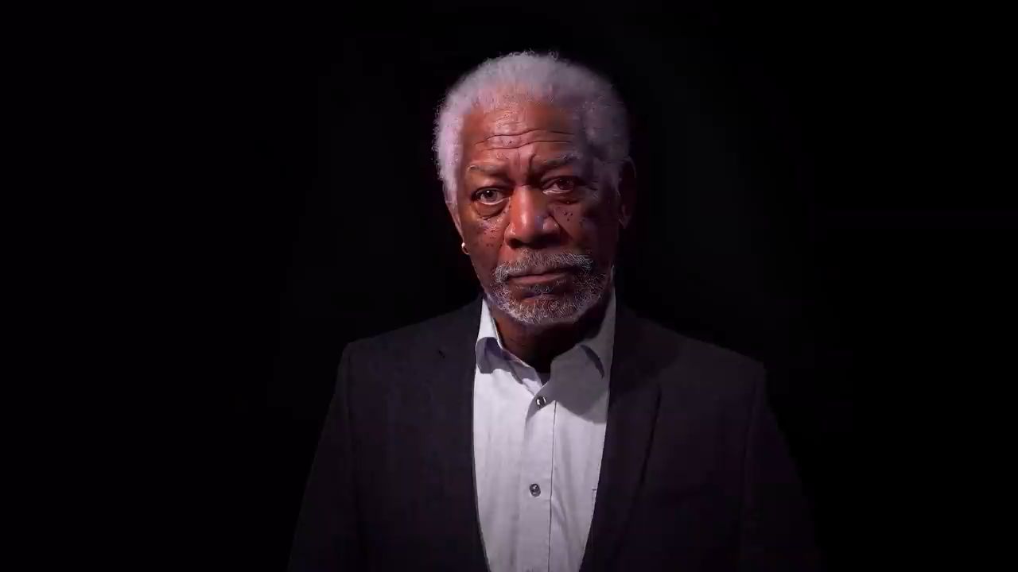
Deepfake identity
Only 7 minutes required to take out identity.

Slide 6
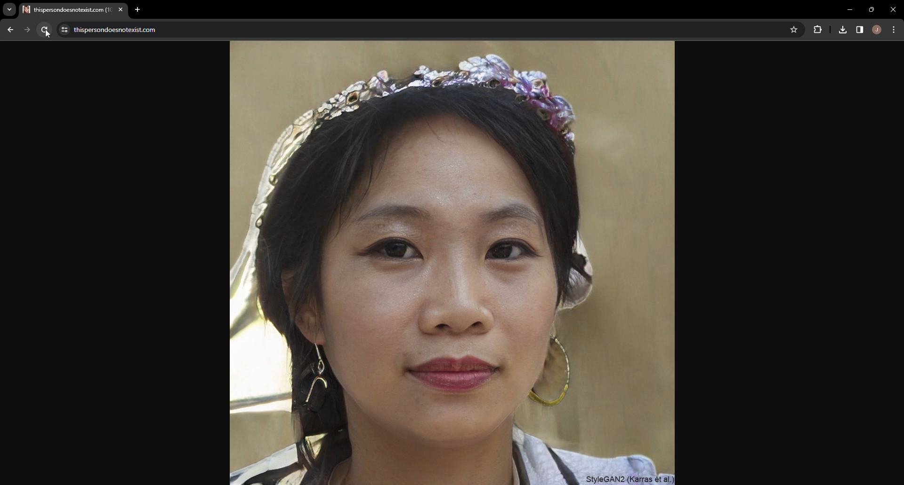
thispersondoesnotexist.com

Slide 7

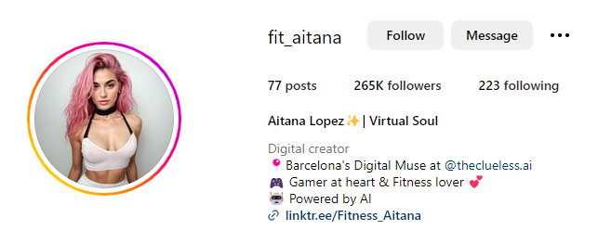
Aitana – ai influencer

Slide 8
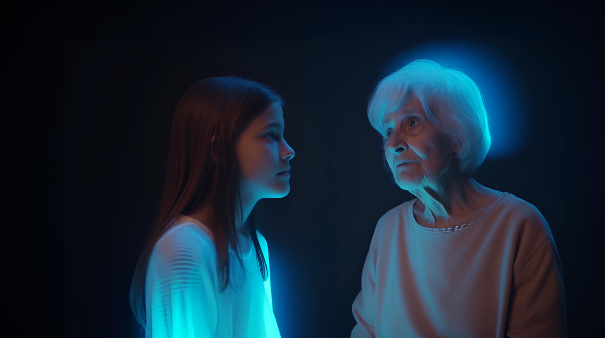
Ai revival
Recreating deceased loved ones with AI

Slide 9
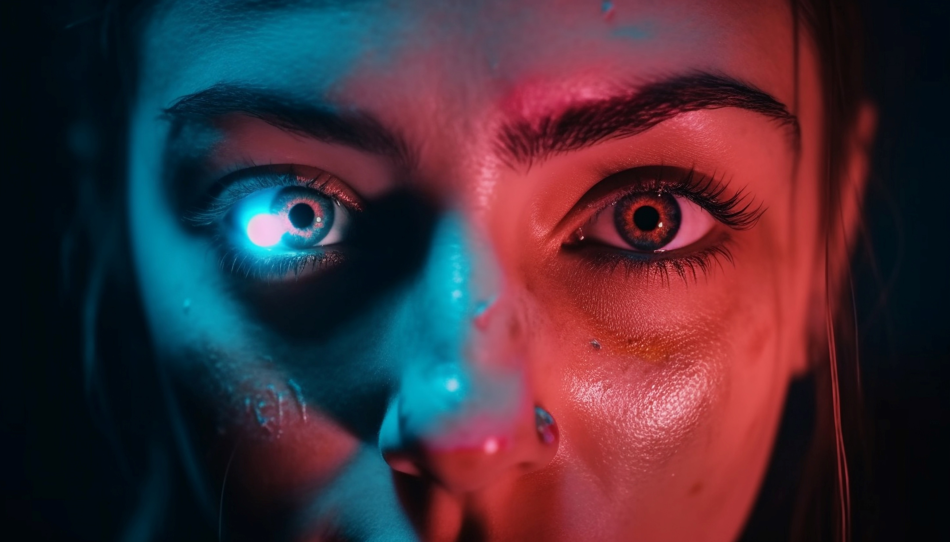
Bad news – How do hackers use AI

Slide 10

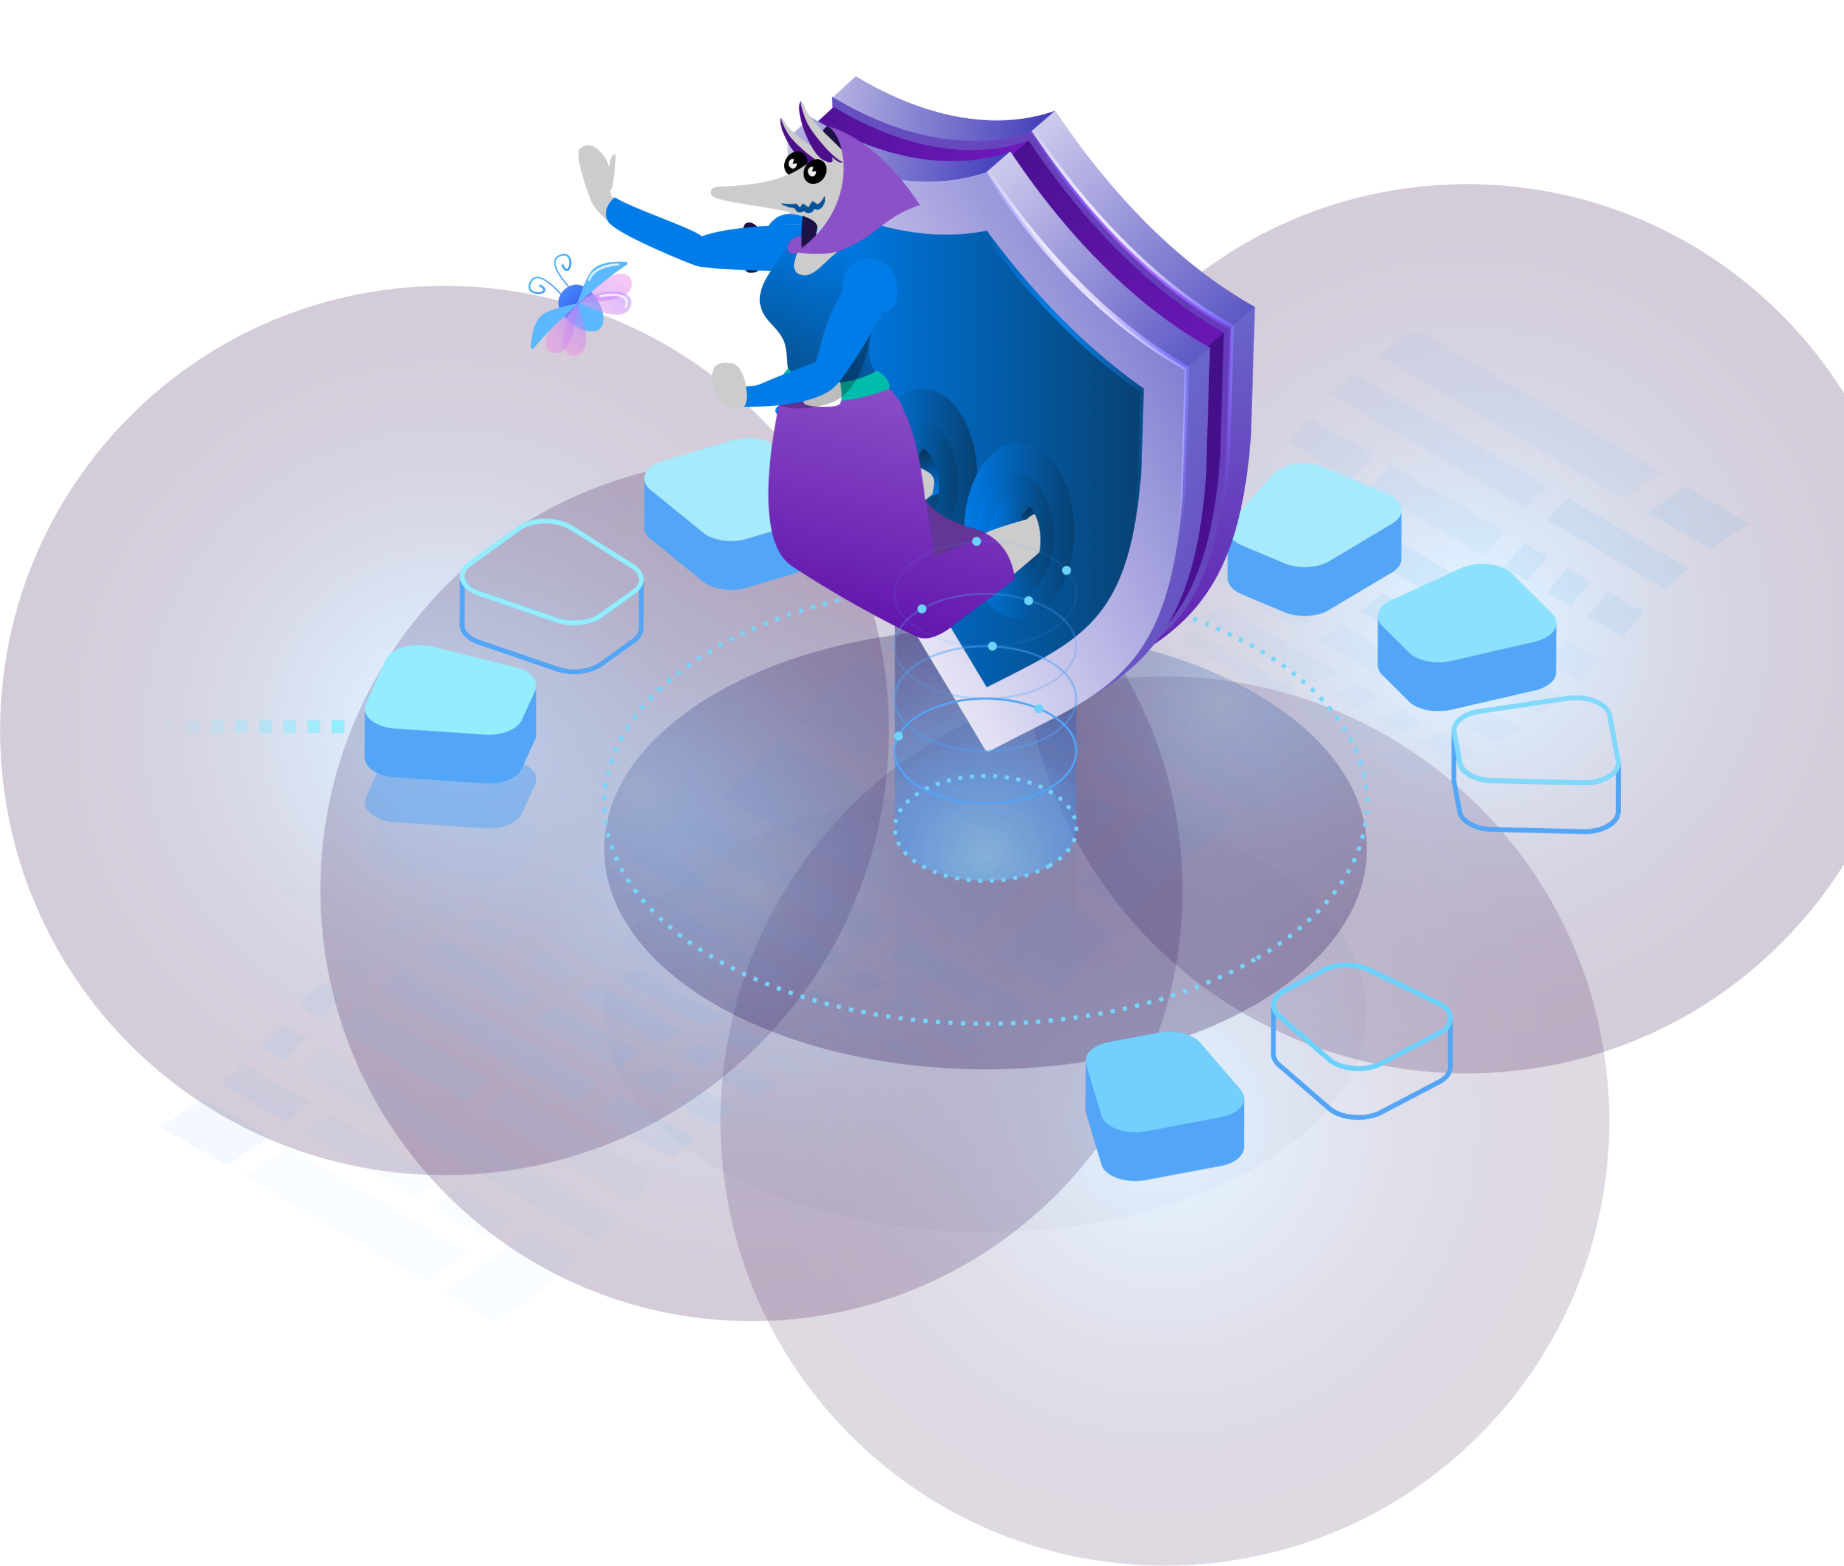
Thank you!

