Slide 1

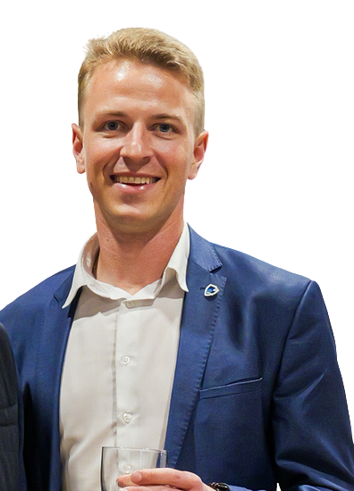

Cybersecurity Matters
Krasimir Kotsev,
CEO, SoCyber

Slide 2

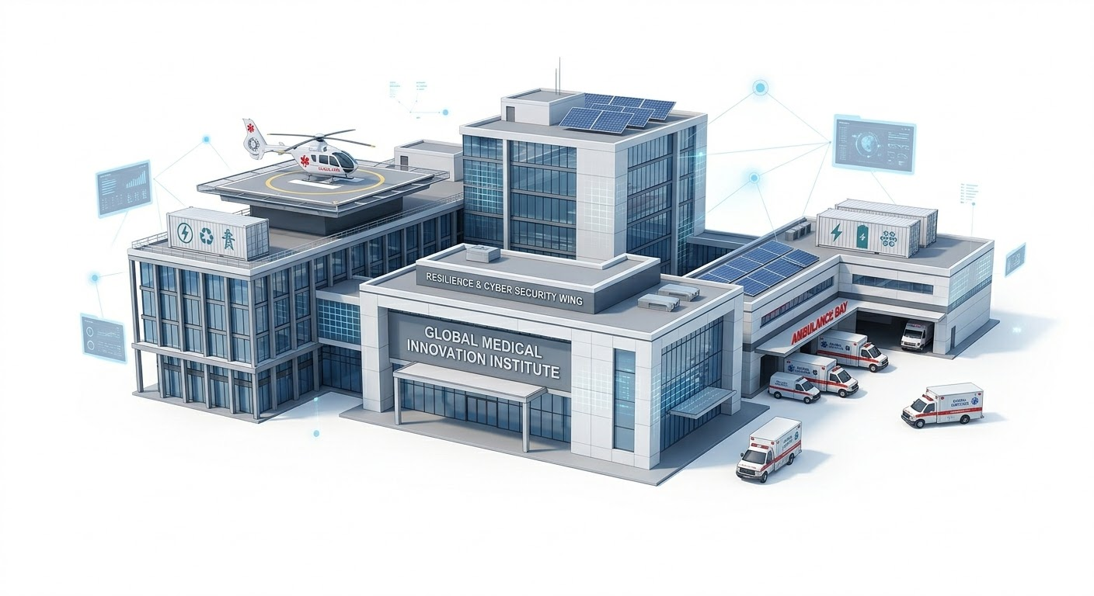
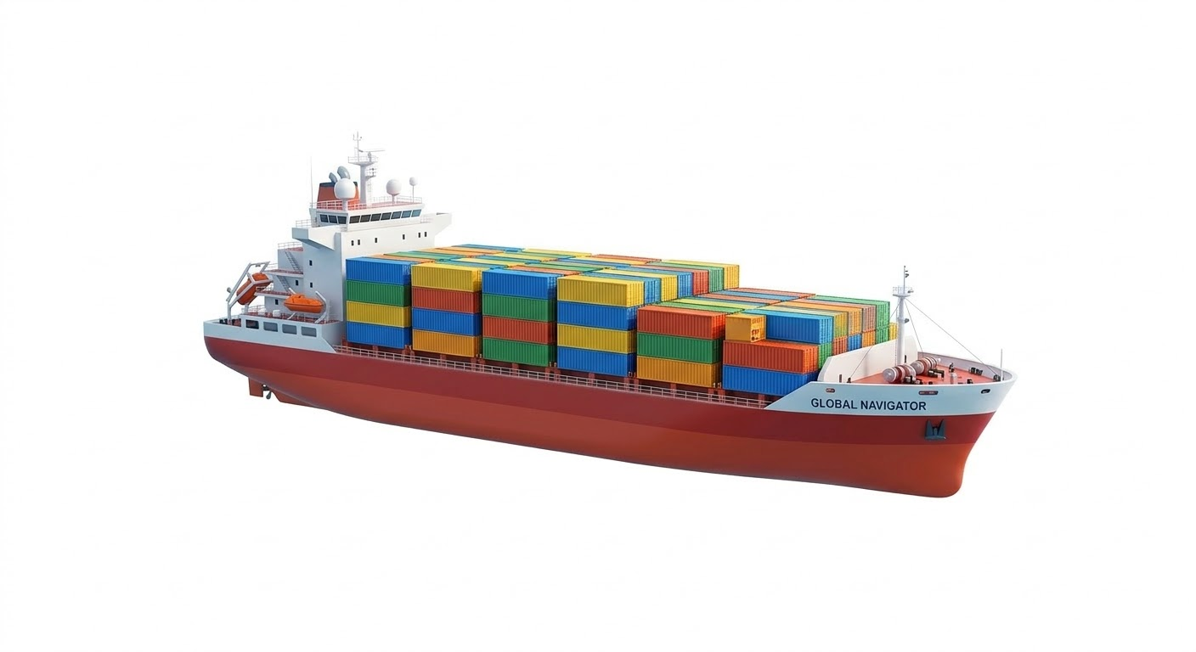
War without borders
Stryker Corporation - 50 TBs of data
Iranian proxy groups delete MSP data
Strait of Hormuz

Slide 3
NIS2: Lawful security
Supply chain risk management
Risk Management, Access Control, Cryptography
Incident Response - 24 hours / 72 hours / 1 month
Non-public National Register of Essential and Important Entities
Governance and oversight by the management body (cyber trainings)
Log collection
Supervision and Enforcement

Slide 4
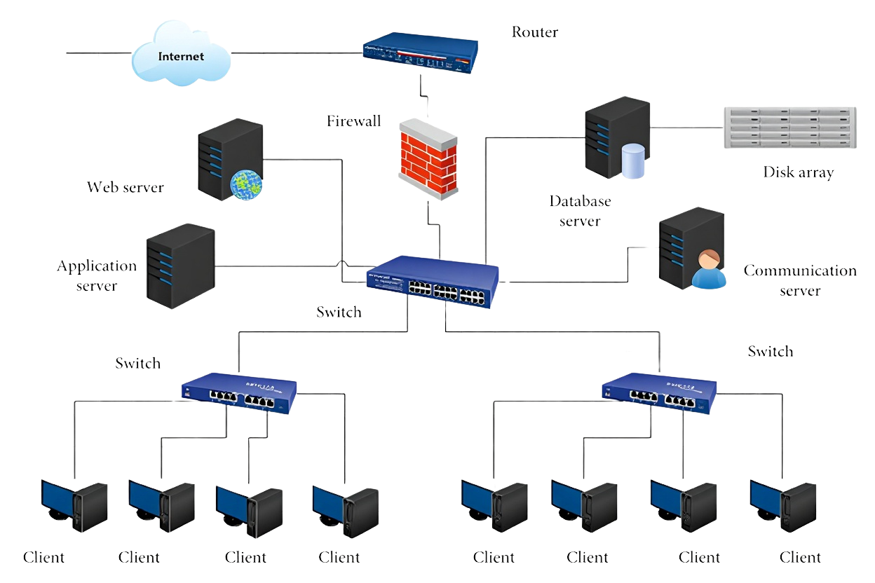
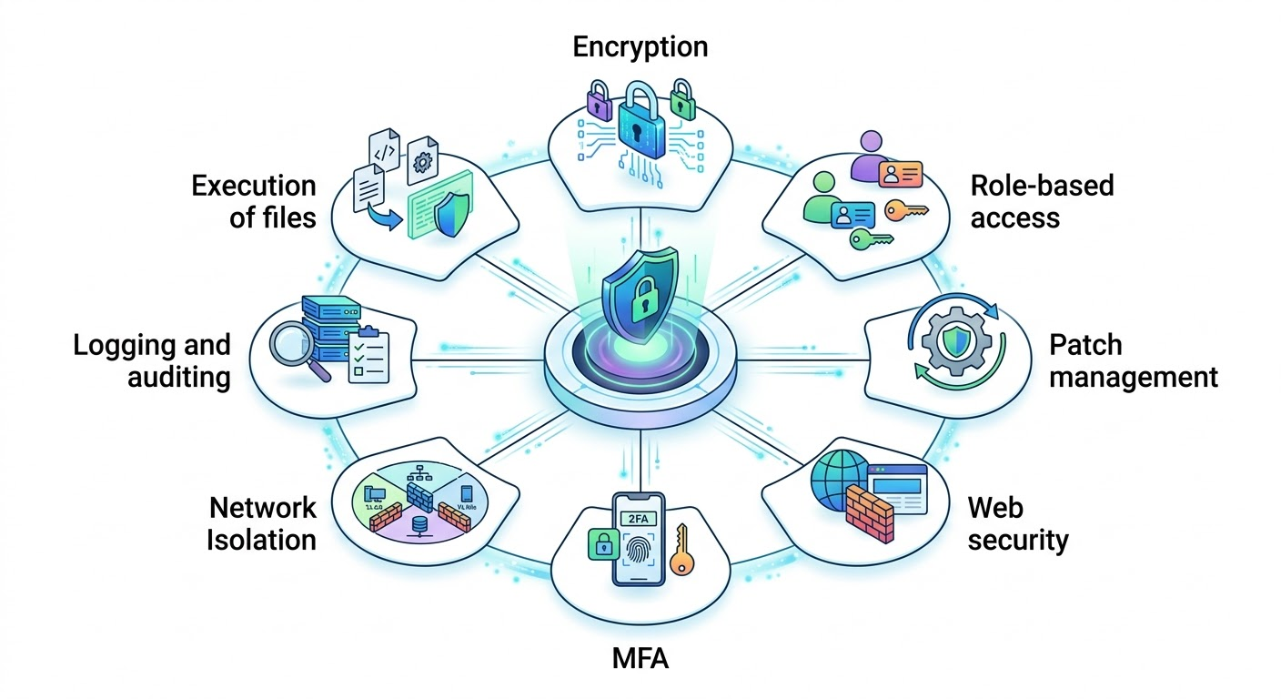




Security Hardening Fundamentals
NO AGENT
AGENT
Deep, granular ​
Real-time​
Advanced​
Centralized​
Visibility: Limited, external Protection: Delayed, limited Detection: Basic
Management: None or limited

Slide 5
The AI deal
Vibe (not)coding
Data Gathering
AI/LLM pentesting
Deep Fakes

Slide 6



SoCyber
Try Kikimora
‘The future of cybersecurity and compliance is agentic!’

