Slide 2

CargoWise AI Agent
Client Demo | January 2026
Transform Logistics Operations with Intelligent Automation

Slide 3
The Challenge
Daily Impact
Slow Customer Response
60+
20+ minutes creating Excel reports for management
minutes wasted on routine queries
System Overload
10+
Toggling between multiple platforms and databases
systems to check manually
100+
customer inquiries per day

Slide 4

The Solution: AI-Powered Intelligence
Natural language. Real-time data. Zero training required.
Universal Search
Smart Alerts
Find any shipment in 3 seconds
Proactive delay notifications
Instant Reports
Integrated Email
Excel exports in one command
Share reports automatically

Slide 5
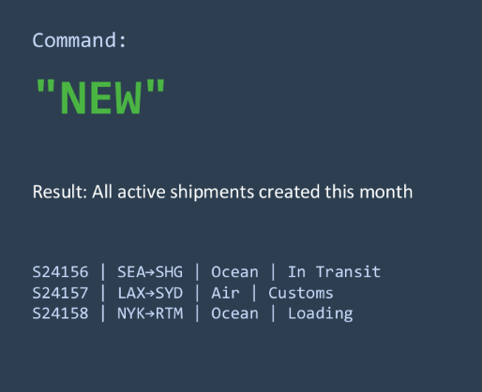
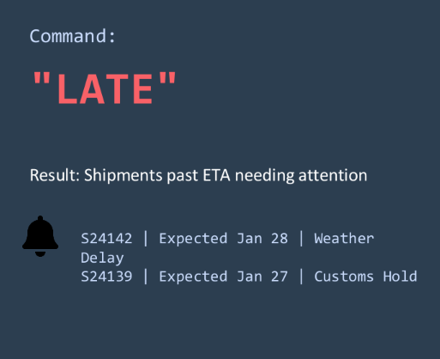
Demo: Morning Priority Check
Use Case: Operations Manager starts the day

Slide 6


Demo: Customer Inquiry Response
Customer calls: "Where is my container TCLU5234567?"
Container: TCLU5234567
Status: In Transit
Current Location: Pacific Ocean (37.5°N, 145.2°W)
Vessel: MAERSK SENTOSA / Voyage 243W
Departed: Long Beach (Jan 22, 08:30 PST)
ETA Shanghai: Feb 5, 14:00 CST
Find any shipment in 3 seconds

Slide 7

Demo: Instant Executive Reports
CEO needs a report for board meeting in 10 minutes
Result:
Step 1: Generate
Step 2: Share
"Export shipments for January 2026 by air mode"
"Email this report to ceo@company.com"
✓ Excel file generated with all shipment details
✓ Outlook opened with pre-filled email and attachment
✓ Ready to send in under 60 seconds

Slide 8
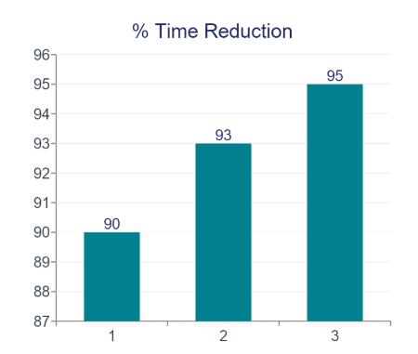

Return on Investment
Daily Impact
3x more customer inquiries handled per staff
Proactive service reduces complaint calls
Professional reports build client trust
Single interface eliminates system switching
Zero training - natural language queries

Slide 9
Complete Feature Set
Seamlessly integrated with CargoWise Enterprise Database
Smart Search
Magic Keywords
Reporting
• Universal search
(Ref/Job/Container)
• Cross-company visibility
• Container tracking
• Routing details
• Milestone history
• "NEW" - Recent shipments
• "LATE" - Delayed shipments
• "TODAY" - Today's activity
• "VIP" - Priority customers
• Custom keywords
• Instant Excel exports
• Email integration
• Multi-filter queries
• Custom date ranges
• Real-time data

Slide 10
Next Steps
30-Day Pilot
Customization
Training
Go Live
Trial with 2-3 users in your operations team
Configure VIP clients and custom keywords
1-hour onboarding session (that's all!)
Full deployment with 24/7 support

Slide 11
Ready to Transform
Your Operations?
Let's schedule your pilot program today

